Slide 1

Setting up Google colab for Deep Learning
Notes:
Colab provides multiple benefits:
It’s open source. So, you can easily share your code with other developers.
You can restrict the permissions to manage accidental changes to your code.
No setup needed.
Provides a rich interactive coding experience.

Slide 2

Google Colab
Yes, you heard it right.
Colab provides GPU and it’s totally free!
Tool for machine learning education and research
Notes:
If you have questions setting up google colab, visit:
https://research.google.com/colaboratory/faq.html
You get a free 12gb of RAM and access to a virtual machine with a high-end CPU/GPU/TPU. Selecting a free GPU is Nvidia Tesla K80.

Slide 3
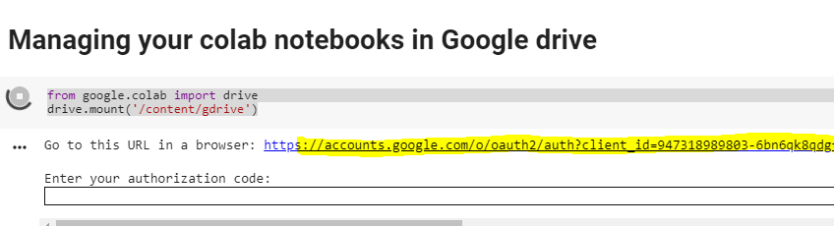
Manage your Google colab notebook
Setting up google Drive
Open the link - https://colab.research.google.com
Type the commands –
from google.colab import drive
drive.mount('/content/gdrive’)

Slide 4
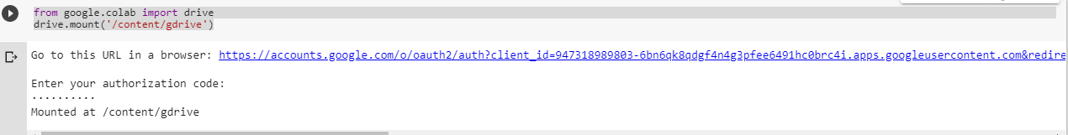
Manage your Google colab notebook
Copy the authorization code generated and paste it into the output shell.

Slide 5

Manage your Google colab notebook
Type the command –
!ls "/content/gdrive/My Drive/Colab Notebooks"

Slide 6
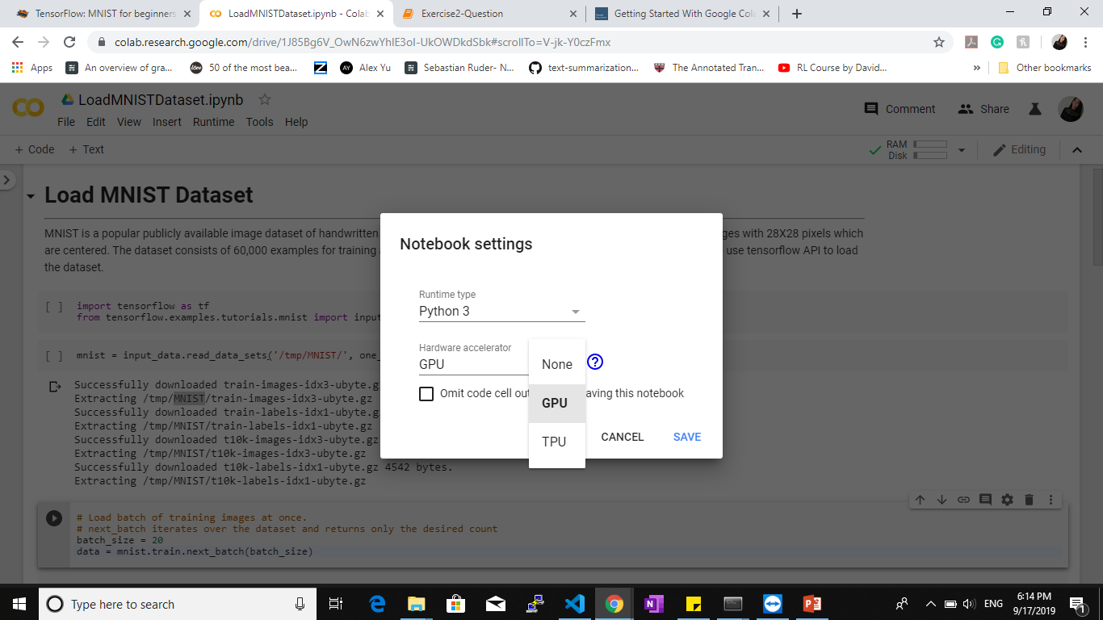
How to setup free GPU?
Runtime > Change runtime type
Select GPU in the Hardware accelerator drop down.
Notes:
TPU: Tensorflow Processing Unit.
If you are using TensorFlow, use a TPU. It is a hardware designed by google to make computations in TensorFlow faster than the GPU.

Slide 7

Verify the setup?
Run the command –
import tensorflow as tf
tf.test.gpu_device_name()
Notes:
TPU: Tensorflow Processing Unit.
If you are using TensorFlow, use a TPU. It is a hardware designed by google to make computations in TensorFlow faster than the GPU.

Slide 8
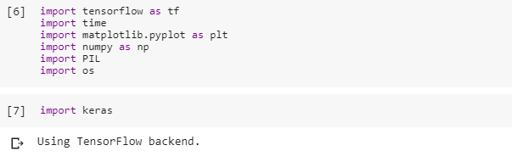
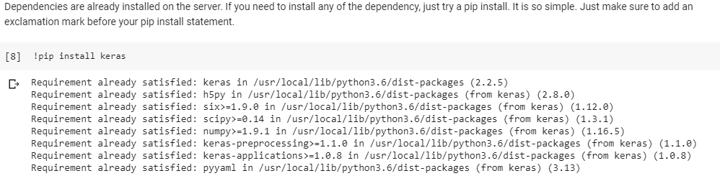
Importing Libraries
Notes:
TPU: Tensorflow Processing Unit.
If you are using TensorFlow, use a TPU. It is a hardware designed by google to make computations in TensorFlow faster than the GPU.

Slide 9
References
https://colab.research.google.com/notebooks/welcome.ipynb

